Slide 1
The Enrollment Landscape

Slide 2
As disruption continues to accelerate in the K–12 market, how do we ensure that independent schools thrive?

Slide 3
The Changing K–12 Enrollment Landscape

Slide 4
Shifts in the private school ecosystem
Number of private schools in the U.S. Percent change from 1999–2000 through 2015–2016
Catholic Schools -14% Other Religious Schools +23%
Nonsectarian Schools +92%
U.S. Department of Education, NCES, Private School Universe Survey 2017–2018 (data from 1999–2000 through 2015–2016)

Slide 5
Growth in public charter schools
Number of charter schools in the U.S.
Percent change from 2006 to 2017
+75%
In 2016–2017
7,000 schools
3.2 million students
National Alliance for Public Charter Schools, Data Dashboard

Slide 6
Twofold growth in homeschooling
Number of homeschooled students in the U.S. Change from 1999 to 2012
850,000 1,773,000
The main reason given by parents for homeschooling their children was their concern about the school environment.
U.S. Department of Education, NCES, Homeschooling in the United States: 2012

Slide 7
Fourfold growth in international schools worldwide
Number of international schools
Change from 2000 to 2019
China is predicted to have 2,200 international schools serving 1 million students by 2028. This has implications for U.S. independent schools given that Chinese students represented 50.3% of international students in NAIS schools in 2017.
Carol Bernate, Jefferson Burnett, and Ioana Suciu Wheeler, “The International Student Outlook,” 2019–2020 NAIS Trendbook
Richard Gaskell, ISC Research, “International School Market Research and Trends” (2018)

Slide 8
Rapidly growing for-profit school sector has focused on (or improving older) education and financial models. For example:
Education Models
Student-led learning (Wildflower Schools)
No traditional teachers (Acton Academy)
Project-based learning (Brightworks)
No traditional grading (Acton Academy)
Use of technology (AltSchool)
Financial Models
Lower tuition (Blyth-Templeton Academy)
Less physical plant (Mysa School)
Network of schools (BASIS Independent Schools)
No fundraising (Portfolio School)
For-profit investments (AltSchool)
Amada Torres, “K–12 Education Landscape Presentation,” NAIS Board Meeting (June 2019)

Slide 9
Emergence of for-profit schools suggests several changes in the market.
Entrepreneur interest and investment in education
A shared desire for personalization in education
A more significant role for technology and data
The middle class priced out of independent schools
The possibility of efficiency and innovation through networks
A generation of parents open to new kinds of education
Millennial employees (teachers and administrators) who may want to be part of something new and disruptive
Amada Torres, “K–12 Education Landscape Presentation,” NAIS Board Meeting (June 2019)

Slide 10
Independent School Enrollment Trends

Slide 11
Independent school enrollment growth/decline varies widely by region.
“The median enrollment at NAIS member schools [in 2017–2018] stayed about the same over the [previous] three years. Nevertheless, a large percentage of schools continue to experience enrollment declines, especially in areas where the number of school-age children is dropping.”
Cities with the highest percentage of growing independent schools: Seattle, Houston, and San Francisco
Cities with the highest percentage of schools losing students: St. Louis, Miami, and Philadelphia
Chicago had the highest percentage of schools in high decline.
Joseph Corbett and Myra McGovern, “The Enrollment Outlook,” 2018–2019 NAIS Trendbook

Slide 12
Admission and enrollment challenges are greater in lower grade levels.
Percent change in median number of applications received from 2013–2014 to 2017–2018
Elementary schools -7.3%
Elementary/middle schools -4.4%
Elementary/middle/ upper schools -.1%
Middle/upper schools -.2%
Upper schools +4.9%
Enrollment: Schools serving higher grade levels reported larger increases in enrollment than other types of schools.
Joseph Corbett and Myra McGovern, “The Enrollment Outlook,” 2018–2019 NAIS Trendbook

Slide 13
Independent school selectivity has dropped slightly.
Percent of applicants admitted
2013–2014
65.3%
2017–2018
67.4%
Yield: Despite admitting more students, independent schools yielded a lower median number of new enrollees in 2017–2018— 68.5% compared with 70.8% in 2013–2014.
Joseph Corbett and Myra McGovern, “The Enrollment Outlook,” 2018-2019 NAIS Trendbook

Slide 14
Enrollment Management Association data show softening in enrollment metrics.
 | 2016 | 2019
We received many more applications than available spots and managed an extensive waiting list of students in several grades. | 11% | 12%
Received more applications than available spots and managed a small waiting list of students in several grades. | 32% | 23%
We generally accepted all qualified students and reached our enrollment goals by the start of the year. | 27% | 32%
We did not reach our enrollment goals until several weeks into the school year. | 7% | 10%
We did not reach our enrollment goals last year. | 22% | 22%
Enrollment Management Association, State of the Independent School Admission Industry (2019)

Slide 15
Recruitment and retention are both challenges at struggling schools.
“High-decline schools … experienced a drop in applications and in the number of newly enrolled students, while high-growth schools saw growth in both applications and newly enrolled students in the last five years….
“Similarly, while attrition increased at schools in the decline categories, there was a decrease in attrition at schools in the growth categories, in particular a 20% decrease in attrition among high-growth schools.”
Cheryl Pruce and Amada Torres, “The Enrollment Outlook,” 2017–2018 NAIS Trendbook

Slide 16
High-decline schools record higher tuition and financial aid per student.
“It could be that financial aid is being used to retain students in order to meet or stabilize enrollment numbers. However, the number of students receiving financial aid increased at high-growth schools and declined at high-decline schools. It may be that high-decline schools have fewer students on aid because their student bodies have declined in size, but it’s likely that the schools are offering larger awards to fewer students.”
Cheryl Pruce and Amada Torres, “The Enrollment Outlook,” 2017–2018 NAIS Trendbook

Slide 17
Today’s Families

Slide 18
Generational changes: Millennial parents’ expectations for education
“[High] Expectations: Millennial parents … want [schools] to provide kids with core academic skills—and more. They view schools and teachers as being their partners in the work of raising their children to be self-sufficient, independent, confident young adults….
“Prepared for college, work, and life: Millennial parents think college-readiness is important, but so too is workforce readiness and preparation for the challenges of life.”
Kristen Soltis Anderson, “Great Expectations: A New Generation of Parents Values Versatility, Accountability in Schools,” Walton Family Foundation (December 6, 2018)
Differences in expectations based on income and education level of parents surveyed: Higher-income parents are more likely ‟to view themselves as playing a major role in holding their child’s school accountable.”

Slide 19
Generational changes: Millennial parents’ expectations for education (cont.)
“Tests plus: Parents believe tests tell only part of the story of how their own child is doing. They also value a positive culture and robust extracurricular activities….
“Taking action: When a school isn’t living up to expectations, millennial parents are open to making changes within a school or giving those children a chance to get that quality education elsewhere.”
Kristen Soltis Anderson, “Great Expectations: A New Generation of Parents Values Versatility, Accountability in Schools,” Walton Family Foundation (December 6, 2018)

Slide 20
Generational changes: Millennial parents’ economic realities
“A study [by the Federal Reserve] found millennials are less financially well-off than members of earlier generations when they were the same ages, with ‘lower earnings, fewer assets and less wealth.’ … Their consumption habits are similar to their parents’ and grandparents’—millennials just have less money to spend….
“They had to face historically weak labor demand and unusually tight credit conditions. Dealing with those financial obstacles probably created ‘attitudes toward saving and spending’ that might be ‘more permanent for millennials than for members of generations that were more established in their careers and lives at that time,’ the study says.”
Emily Sullivan, “Why Aren’t Millennials Spending? They’re Poorer Than Previous Generations, Fed Says,” NPR (November 30, 2018)

Slide 21
Generational changes: Millennial parents’ behaviors
“The pool of applicants is much smaller. In 2016, 56% of millennials ages 25–35 were childless….
“Most millennial parents can’t afford private school education. Millennial households have the highest number of households under the poverty line….
“Millennials use Google for everything. The way parents research private schools has changed dramatically….
“Millennials’ brand loyalty is weak….
“Millennial parents prefer video to reading.”
Borrowers nationwide owe a total of $1.5 trillion in federal student loan debt.
Mia Major, “Marketing Your School to Millennial Parents: Eight Truths You Need to Know,” Finalsite (June 7, 2018)

Slide 22
NAIS research identifies the four “Jobs” parents “hire” independent schools to do.
Job 1: When my child’s school is failing him or her—either academically or by not providing a safe learning environment—help me find a school that will address those obstacles, so I can ensure that my child will not fall further behind and will eventually thrive in school.
Job 2: When I have a child who is intelligent and emotionally mature, help me find a school that will continue that growth so I can ensure my child will fulfill his or her potential, mature, and be prepared for college.
What Jobs do parents primarily hire your school to do? NAIS conducted research on parental decision-making using a methodology called Jobs to Be Done. The findings, drawn from a series of interviews with parents who recently made an enrollment decision for their children, can help schools focus on what matters most to families.
NAIS, Why Do Parents Choose Independent Schools? (nais.org/articles/
pages/member/research/nais-research-jobs-to-be-done-study-on-independent-school-parents)

Slide 23
NAIS research identifies the four “Jobs” parents “hire” independent schools to do (cont.)
Job 3: When a school is focused almost solely on test scores and academic curriculum, help me find a school that will focus on my child’s social and emotional development, so I can be sure that my child will be a well-rounded and productive member of society.
Job 4: When my child has talents that must be cultivated and I have a select set of acceptable colleges, help me find a school with an excellent academic program and outstanding reputation, so I can ensure my child gets into one of the select set of schools and fulfills his or her potential.
NAIS, Why Do Parents Choose Independent Schools?

Slide 24
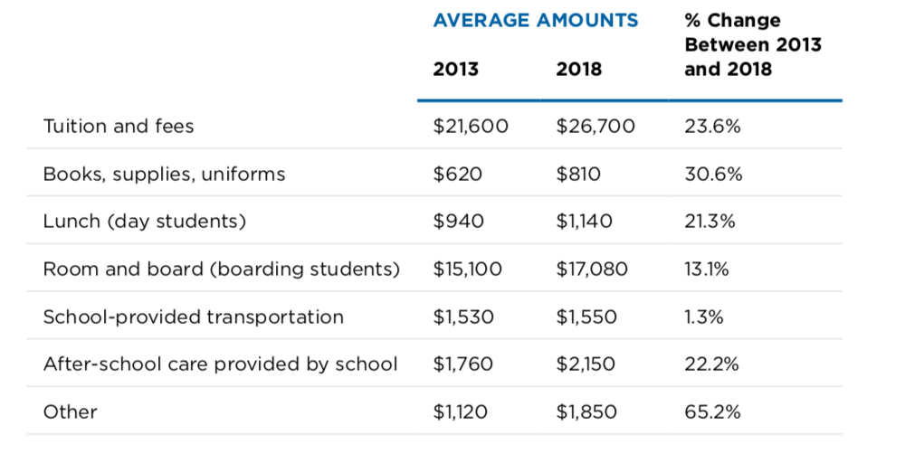
Total cost of attendance at independent schools has risen, as reported by parents.
The NAIS survey How Parents Pay School Costs asked families who applied for financial aid how they pay for tuition, what role financial aid plays in their enrollment decisions, and how they feel about paying tuition.
Mark J. Mitchell, How Parents Pay School Costs, NAIS (2019)

Slide 25
In independent schools, families’ reliance on financial aid has grown.
Percent of families surveyed* who reported that they needed financial aid for their child to attend independent school
2006 2013 2018
62% 80% 88%
*NAIS surveyed families who applied for financial aid.
Mark J. Mitchell, How Parents Pay School Costs, NAIS (2019)

Slide 26
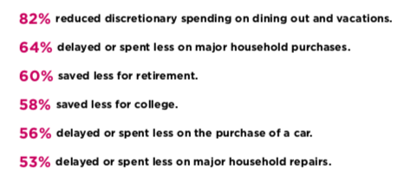
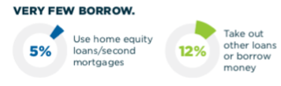
In independent schools, families largely rely on personal income to cover costs.
Three-quarters of families surveyed* use personal income to pay costs. Most put off current spending or savings goals instead of incurring debt or seeking help from others. This raises the stakes on the financial aid offer.
*NAIS surveyed parents who applied for financial aid.
Mark J. Mitchell, How Parents Pay School Costs, NAIS (2019)

Slide 27
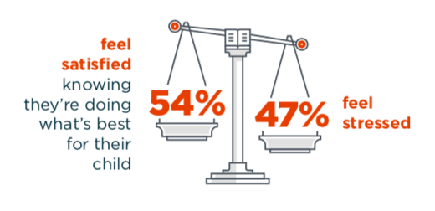
Satisfaction and stress in paying for independent schools
About half of the families surveyed* reported that their foremost emotion in paying for private school was satisfaction (making the right choice for their child). About half said that they felt stressed. These findings underscore the need to be clear and up front about affordability, aid, and payment options.
*NAIS surveyed parents who applied for financial aid.
Mark J. Mitchell, How Parents Pay School Costs, NAIS (2019)

Slide 28
What Schools Can Do

Slide 29
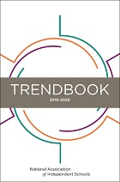
Making incremental progress in key areas
“[School] leaders must keep one foot firmly in today and the other just as firmly in tomorrow. How is that even possible? And how can we make it more doable? I believe it comes down to making incremental progress —taking small steps—in a few key areas.
“Based on research in other industries, I am confident that the schools that will weather the changes ahead will have three characteristics in common:
strong, sustained leadership,
a laser-sharp focus on their mission,
and the ability to innovate continuously.”
Donna Orem, “Epilogue,” 2019–2020 NAIS Trendbook

Slide 30
Lessons from schools that have closed
Four factors that commonly contribute to the closing of independent schools:
Mission fatigue: The school’s mission is no longer sought after in the marketplace.
Leadership transition: awkward transitions, most notably when a founding head retires and passes the torch to the next generation of leadership
Financial problems: money woes driven by many causes, from demographic changes to mismanagement
Poor planning: lack of strategic planning or an orientation that favors short-term, small-picture thinking instead of long-term planning
Donna Orem, writing on the Independent Ideas blog, summarizing Jim McManus, “What Dead Schools Can Teach Us,” Independent School magazine (Fall 2012)

Slide 31
Lessons from companies that have failed
Stages of organizational decline:
Hubris born of success: Success is seen as an entitlement. Organizations that fall prey to this think, “We’re successful because we do specific things,” instead of “We’re successful because we understand why we do these specific things and under what conditions they would no longer work.”
Undisciplined pursuit of more: Building on their hubris, organizations grow faster than their capacity allows or take undisciplined leaps.
Denial of risk or peril: External results may be strong enough that leaders fail to see or heed warning signs. They also blame external circumstances for challenges instead of taking responsibility.
Grasping for salvation: Leaders are prone to look for the quick fix instead of taking a disciplined approach that could bring them out of decline.
Capitulation to irrelevance or death: Accumulated setbacks catch up with the organization, and leaders often abandon the possibility of building a future where they could thrive.
Donna Orem, writing on the Independent Ideas blog, summarizing
Jim Collins, How the Mighty Fall: and Why Some Companies Never Give In (2011)

Slide 32
Next Steps
Consider the change in each sector of the K-12 landscape. Discuss with your leadership team what opportunities and challenges this disruption presents for your school.
After discussing national independent school admission trends, study your own admission funnel. How has it changed? How does it differ by grade? How does it compare to that of local competitors?
Explore the Jobs-to-Be-Done methodology in the context of your school’s current and prospective families. Determining what motivates your current and prospective parents can help your school focus its offerings and rein in expenses. It can also help you tailor how you communicate your school’s unique value.
Keeping in mind the research about how parents pay, discuss what you can do to improve your affordability strategy. For example, share the full cost of attendance at your school, examine trends in yield rate among financial aid recipients, and align expectations about financial aid (e.g., by providing an online financial aid calculator).
Review the lessons from failed schools and companies in the context of your own school. Do you see your school in any of the stages described by Jim Collins? Examine market data, and begin to sketch out a disciplined approach for becoming more sustainable. Take on Collins’ challenge to explore the statement: “We’re successful because we understand why we do these specific things and under what conditions they would no longer work.”
Commit to making progress in the year ahead in three areas that are critical to your school’s sustainability: strong sustained leadership, a focus on mission, and a willingness to innovate.

Slide 33
Resources
U.S. Department of Education, NCES, Private School Universe Survey 2017–2018
National Alliance for Public Charter Schools, Data Dashboard
U.S. Department of Education, NCES, Homeschooling in the United States: 2012
Richard Gaskell, ISC Research, “International School Market Research and Trends”
Carol Bernate, Jefferson Burnett, and Ioana Suciu Wheeler, “The International Student Outlook,” 2019–2020 NAIS Trendbook
Amada Torres, “K–12 Education Landscape Presentation,” NAIS Board Meeting
Joseph Corbett and Myra McGovern, “The Enrollment Outlook,” 2018–2019 NAIS Trendbook
Enrollment Management Association, State of the Independent School Admission Industry
Cheryl Pruce and Amada Torres, “The Enrollment Outlook,” 2017–2018 NAIS Trendbook
Kristen Soltis Anderson, “Great Expectations: A New Generation of Parents Values Versatility, Accountability in Schools,” Walton Family Foundation
Emily Sullivan, “Why Aren’t Millennials Spending? They’re Poorer Than Previous Generations, Fed Says,” NPR
Mia Major, “Marketing Your School to Millennial Parents: Eight Truths You Need to Know,” Finalsite
NAIS, Why Do Parents Choose Independent Schools?
Mark J. Mitchell, How Parents Pay School Costs, NAIS
Donna Orem, “Epilogue," 2019–2020 NAIS Trendbook
Donna Orem, “To Be Successful in Today’s Education Market, Learn From the Past” Independent Ideas blog, NAIS
Jim McManus, “What Dead Schools Can Teach Us,” Independent School magazine
Jim Collins, How the Mighty Fall: and Why Some Companies Never Give In

